Slide 1


Mobility as a Service
Piia Karjalainen
Senior Manager, MaaS Alliance
@PiiAnnika
Sami Sahala

Slide 2
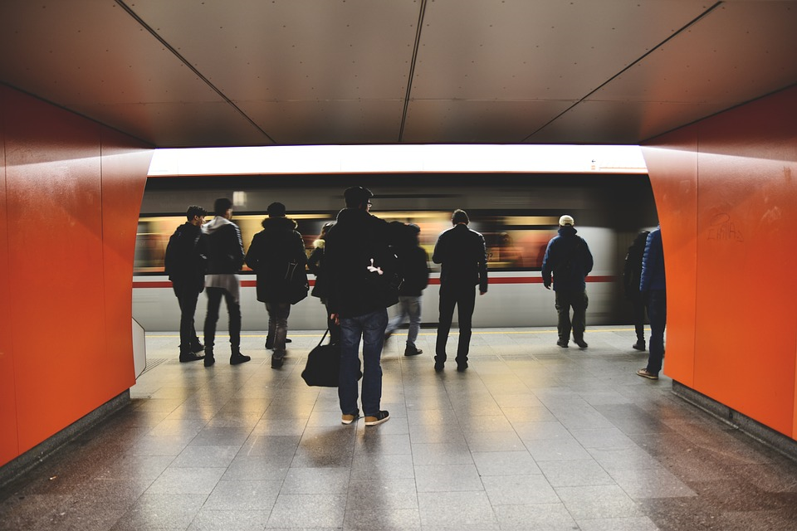
What we are talking about when we are talking about MaaS?
Multimodal
Single payment
Constantly informed user
Add-on services

Slide 3
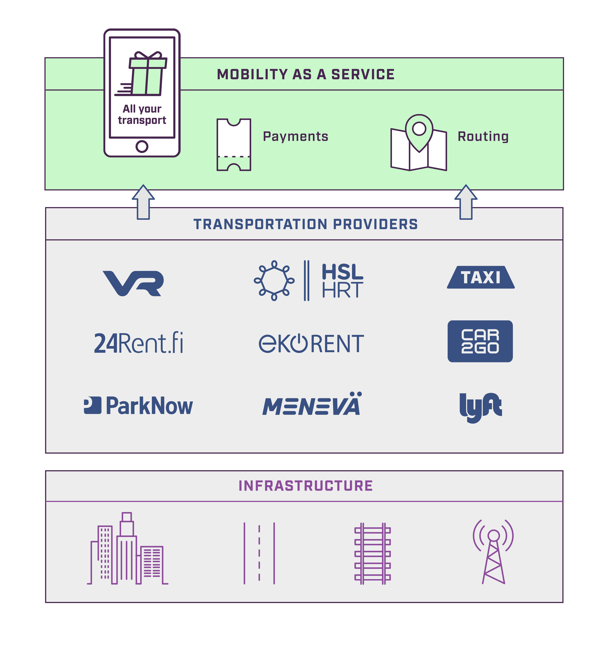
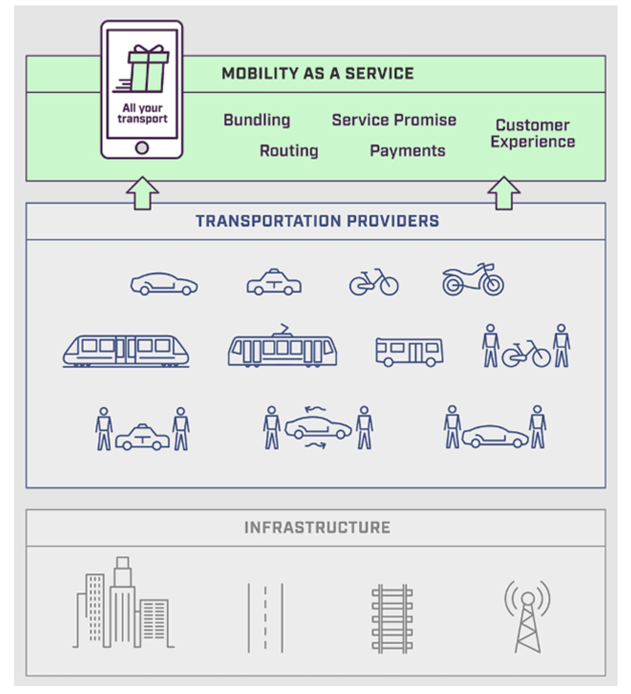

3

Slide 4
MaaS does not compete with transport, will not replace any transport service.
MaaS is a way to access (plan, buy, use) ALL transport
MaaS can be considered as a new extra sales channel
4

Slide 5
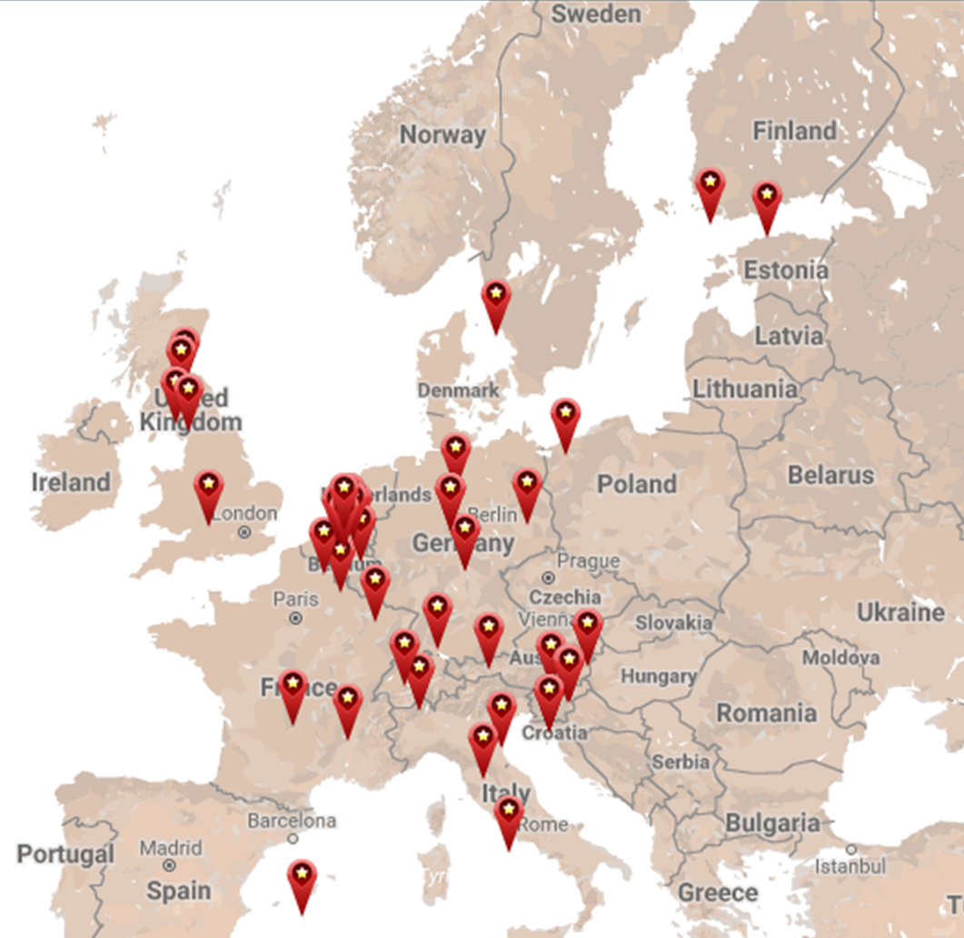
Open Ecosystem
MaaS provider: access to market
Transport operators: freedom to supply
User: roaming of services
Open data, open APIs

Slide 6
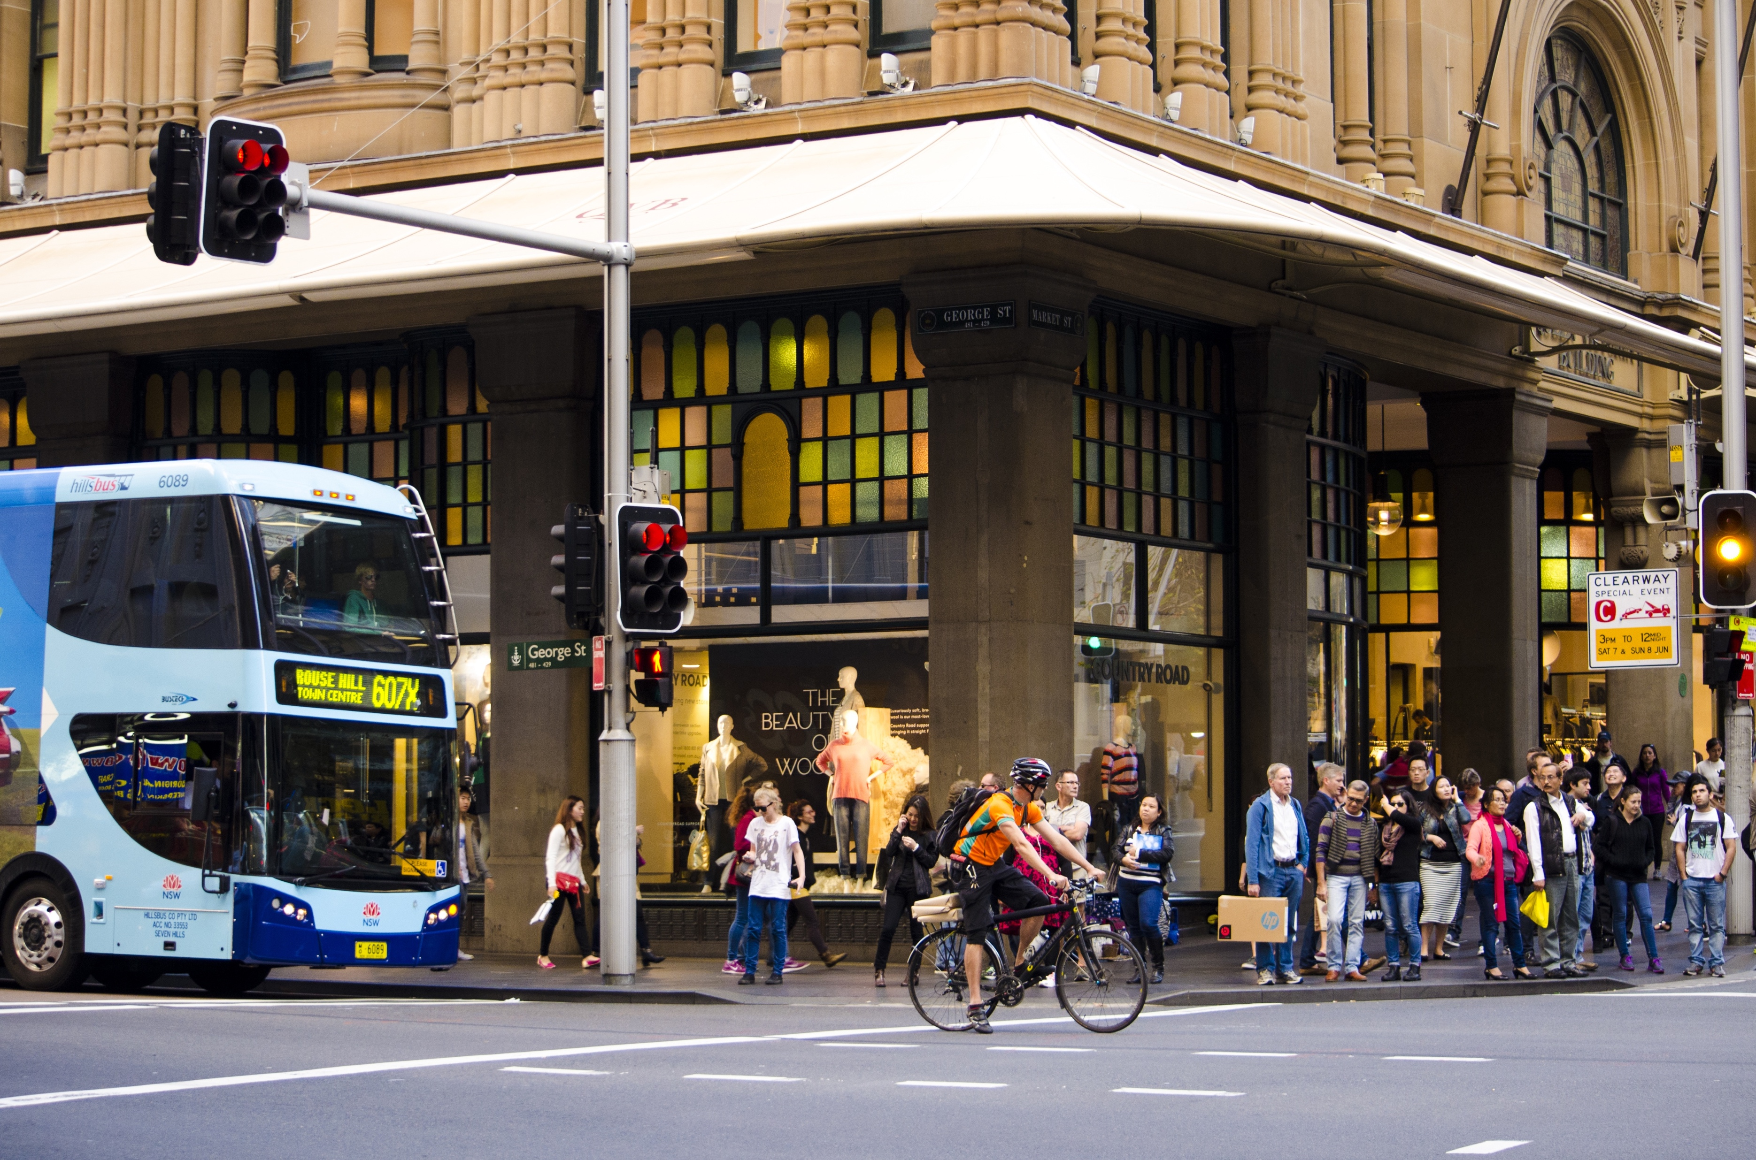
How can public sector encourage MaaS?
Ensure access to the mobility market
Avoid creation of bottlenecks, monopolies or closed systems
Work with open data, open architectures and standard interfaces
Take advantage of the opportunities offered by MaaS to meet policy goals
Consider initial investments to jump-start the ecosystem

Slide 7

CASE FINLAND Transport Code - Customer in Focus
DIGITALISATION
MOBILITY AS A SERVICE MULTIMODALITY

Slide 8










Easier market access, more room for innovation
Less red tape
Streamlining across models and services
Technology neutral rules

Slide 9


Multiple business models,
integration,
tools to react
Open competition, smart incentives
Streamlined regulation
+
=

Slide 10
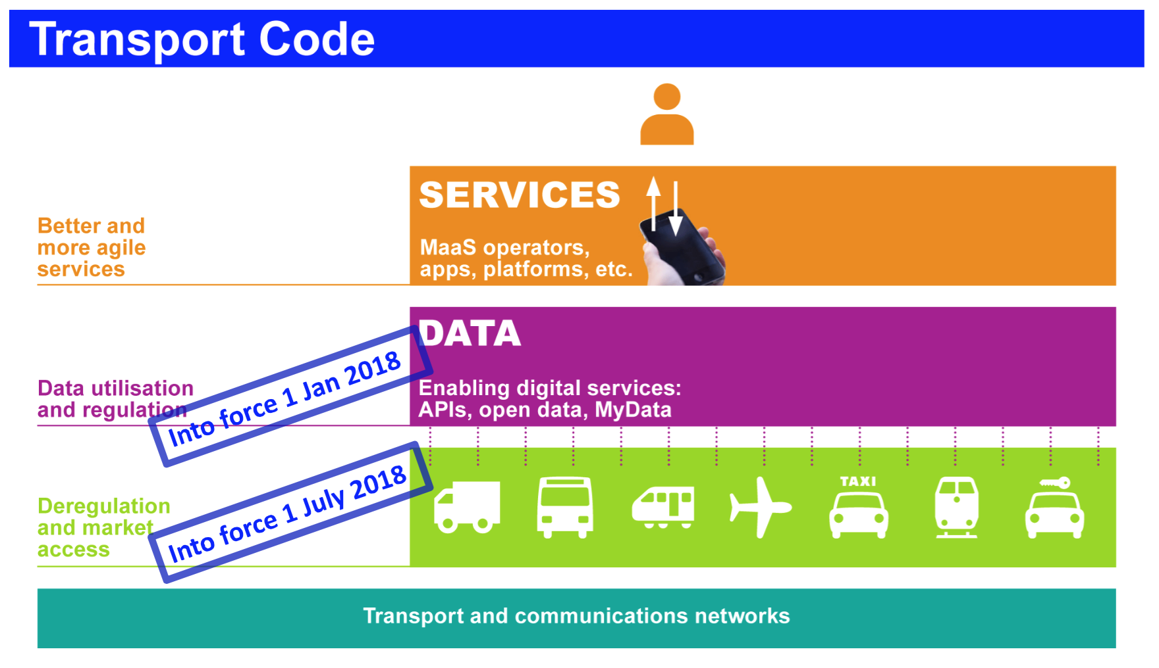

Slide 11
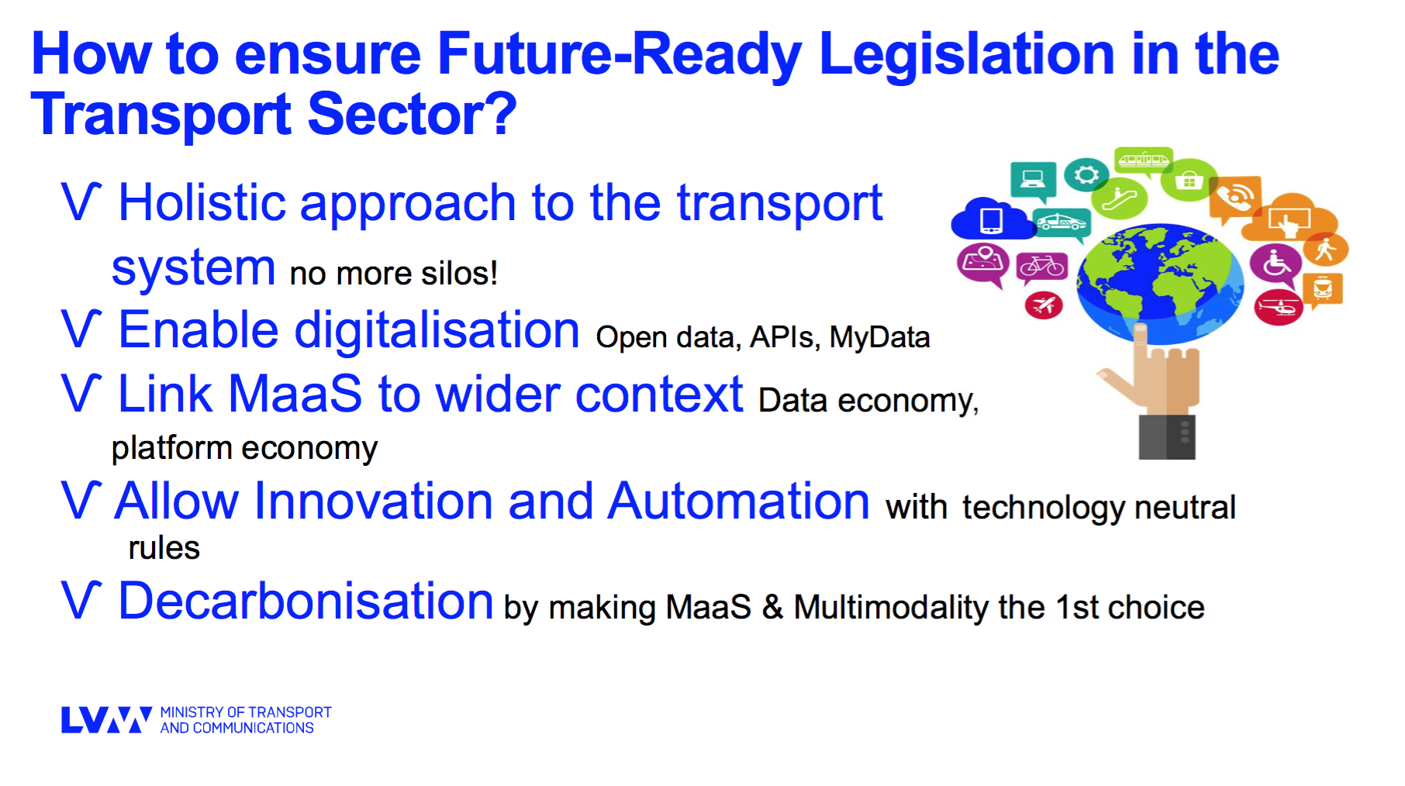

Slide 12

Success factors of Maas
As (or more) attractive than owning a car in terms of
flexibility, certainty and costs
User-centric: quality of service should be fully delivered from the beginning, providing painless travelling
More environmentally friendly than conventional transport system, more cost efficient for public sector
Scalable, roamable – and based on the best local ingredients
Deep understanding on the rules of data economy required
MaaS Alliance White Paper:
https://maas-alliance.eu/wp-content/uploads/sites/7/2017/09/MaaS-WhitePaper_final_040917-2.pdf

Slide 13
To foster the environmental benefits of MaaS schemes
To develops business models and partnerships to encourage MaaS
To ensure that the Maas user is always “better off”
To promote the development of an open and inclusive MaaS ecosystem
To strengthen the interopera-bility of technologies and roaming of services
What do we need MaaS Alliance for?

Slide 14





































MaaS Alliance Members
MaaS Alliance Members on 09.10.2017.

Slide 15


E-mail: info@maas-alliance.eu
Website: www.maas-alliance.eu
Twitter: @MaaS_Alliance
sami.sahala@forumvirium.fi

